Slide 1
Capstone Project-Battle of Neighborhoods
Week 1

Slide 2
Introduction
The best location to establish a hotel/restaurant in Goa,India?
Goa is a state on India’s west coast. It is a former Portuguese colony with a rich history. Spread over 3,700 square kilometers with a population of approximately 1.8 million, Goa is small by Indian standards. It has a unique mix of Indian and Portuguese cultures and architecture that attracts an estimated 2.5 million visitors each year (including about 400,000 foreign tourists).
It is a popular vacation destination for both domestic and international tourists almost around the year. It is famous for its pristine beaches, old Portuguese churches and its relaxed environment. Goa’s cuisine is a rich blend of Indian and Portuguese palates.
It has been observed that on visiting Goa, people usually want to pick a hotel which is close to a beach therefore such hotels continue to do a lot of business year around.
Essentially this is the question that we’d like to answer through this project

Slide 3

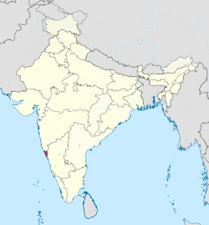
Dataset
We will be completely working on Foursquare data to explore and try to locate our new hotel where more venues like beaches, churches, museums and memorials that are present nearby.
How will we be solving using this data?
We will looking for midpoint area of venues to locate our new hotel. Before that our major focus will be on all venues present in and around the center of Goa.
We will perform some exploratory data analysis on hotels and restaurants present in the tourist spot.
The project notebook will consist of essential libraries and code which will be submitted later on GitHub.

